Slide 1
DAA Final Project Title: Employee Churn Prediction

Slide 2
Problem Statement
The problem aims early detection of employee who is likely to leave the organization.
Employee churn, represents the phenomenon in which employees leave a company either voluntarily or involuntarily.
High employee churn rates can have detrimental effects on an organization.
For that, employee retention is a critical concern for organizations, as high employee turnover can lead to increased recruitment costs, loss of institutional knowledge, and a negative impact on overall productivity.

Slide 3
Data Description
The project begin with the acquisition of a dataset, "HR_comma_sep.csv," obtained from Kaggle containing information about 14,999 employees. This dataset encompasses the following key features:
Satisfaction Level: A measure of employee job satisfaction.
Last Evaluation: The most recent performance evaluation score.
Number of Projects: The number of projects each employee has been involved in.
Average Monthly Hours: The average number of hours worked per month.
Time Spent in the Company: The duration an employee has worked in the organization.
Promotion in the Last 5 Years: Whether an employee has been promoted in the last five years (binary feature).
Work Accident: Whether an employee involved in any work accident or not (binary feature).
Department: The department in which the employee is employed.
Salary: The salary level of the employee(High, Medium & Low).
Left: A binary variable indicating whether the employee left the company (our target variable).

Slide 4
Data Preprocessing
Effective data preprocessing is a crucial step in preparing the dataset for analysis and modeling.
The following preprocessing steps were carried out:
Salary Categorization: The "Salary" column was transformed into a categorical variable and encoded into numerical values (e.g., low, medium, high) to facilitate machine learning algorithms' utilization.
Department One-Hot Encoding: To make the "Department" feature suitable for machine learning models, it was one-hot encoded into binary columns representing each department.

Slide 5
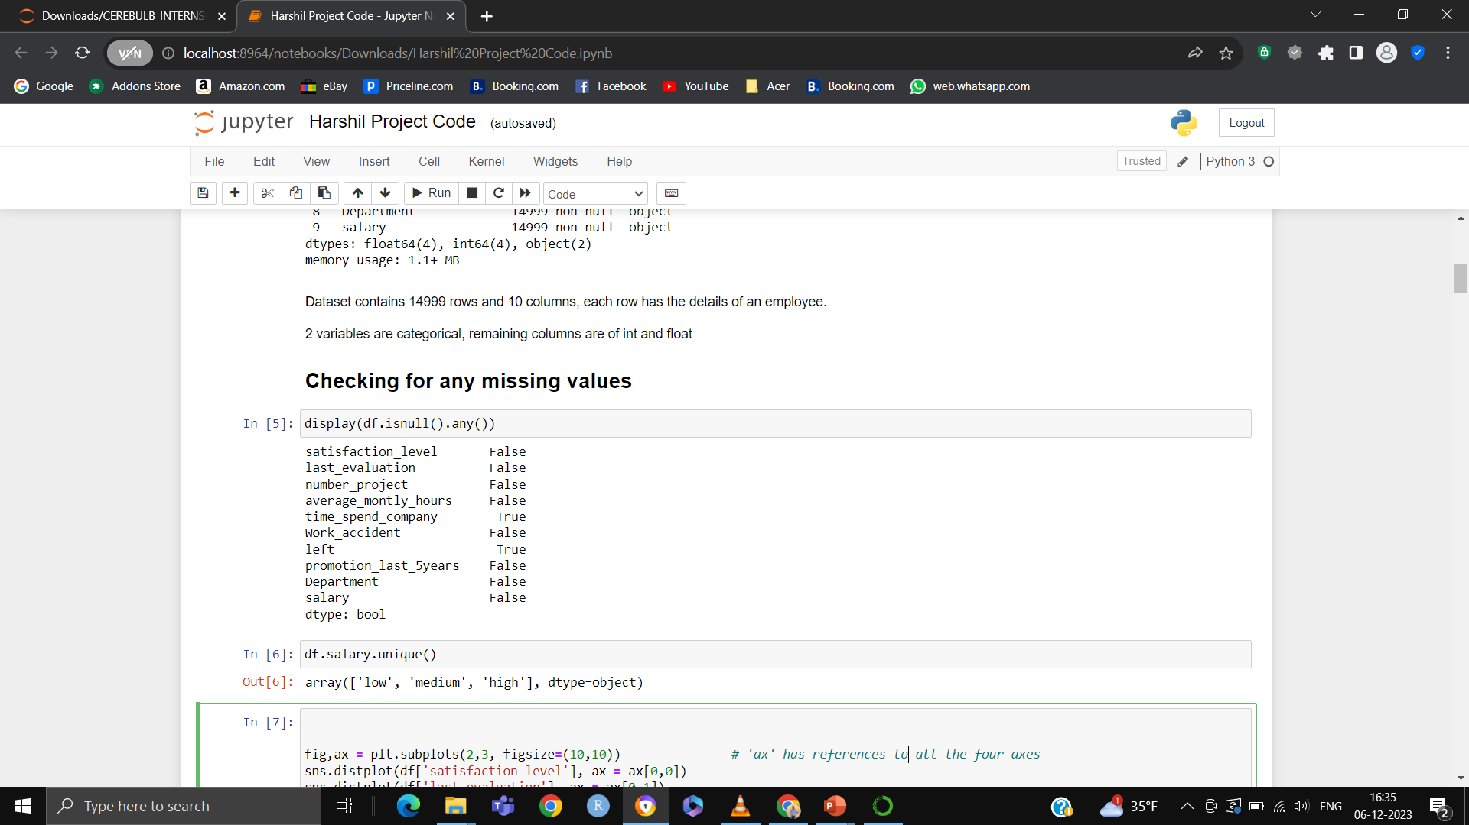
Data Preprocessing
Also, handling the missing values is the crucial part for any dataset.
While checking for missing values we found there are two attributes with some missing values.
To handle that missing values we used two different methods:
For time_spend_company column we used forward fill method.
And for left column we used drop method.

Slide 6
Exploratory Data Analysis (EDA)
After analyzing the data we found these several reasons:
Approximately 76% of employees chose to remain with the company, while roughly 24% decided to leave.
The departments with the highest number of employees were Sales, Technical, and Support, in descending order.
The HR department had the highest employee churn rate, followed by Accounting, Technical, Sales, and Support.

Slide 7
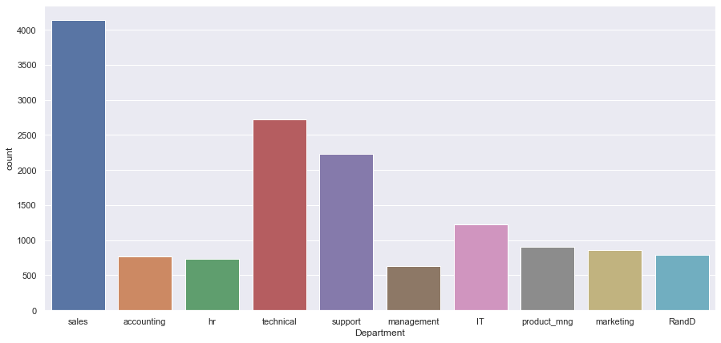
Exploratory Data Analysis (EDA)
As we can see in the chart sales department has more employees, next comes technical and Support departments.

Slide 8
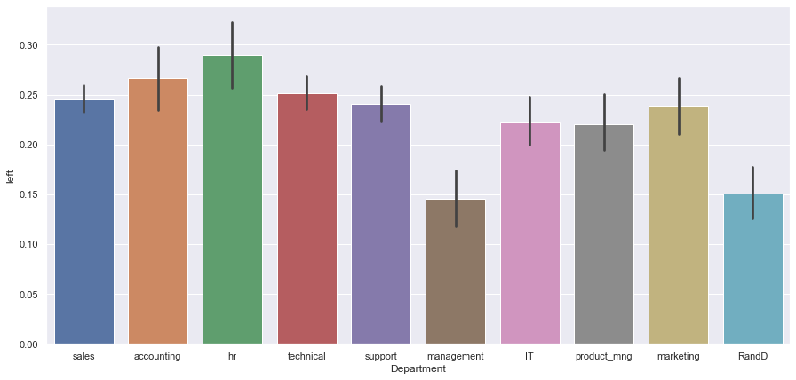
Exploratory Data Analysis (EDA)
By, this chart we can see HR department has highest churn rate, next was accounting, technical, sales and support so on.

Slide 9
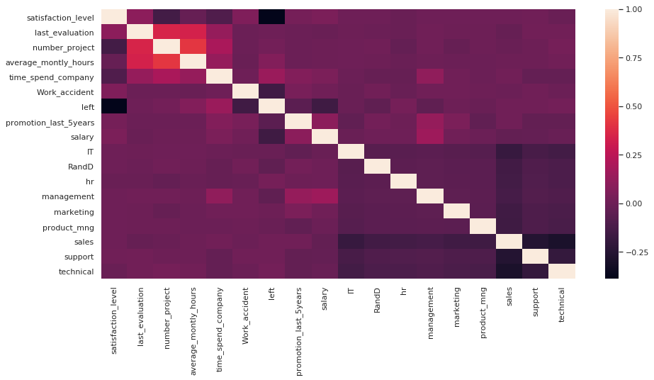
Exploratory Data Analysis (EDA)
A correlation matrix was constructed to identify potential relationships and dependencies among the various features.

Slide 10
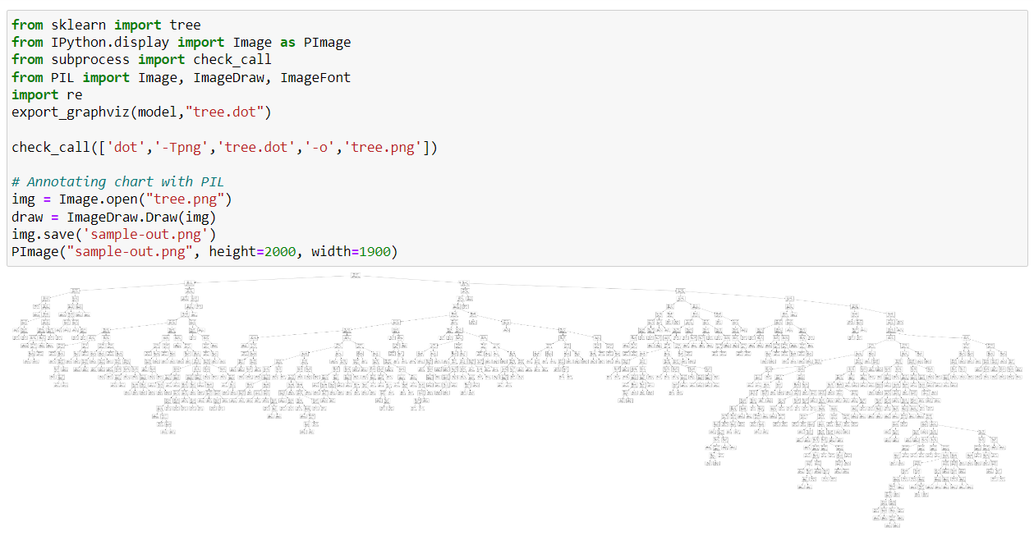
Decision Tree Model

Slide 11
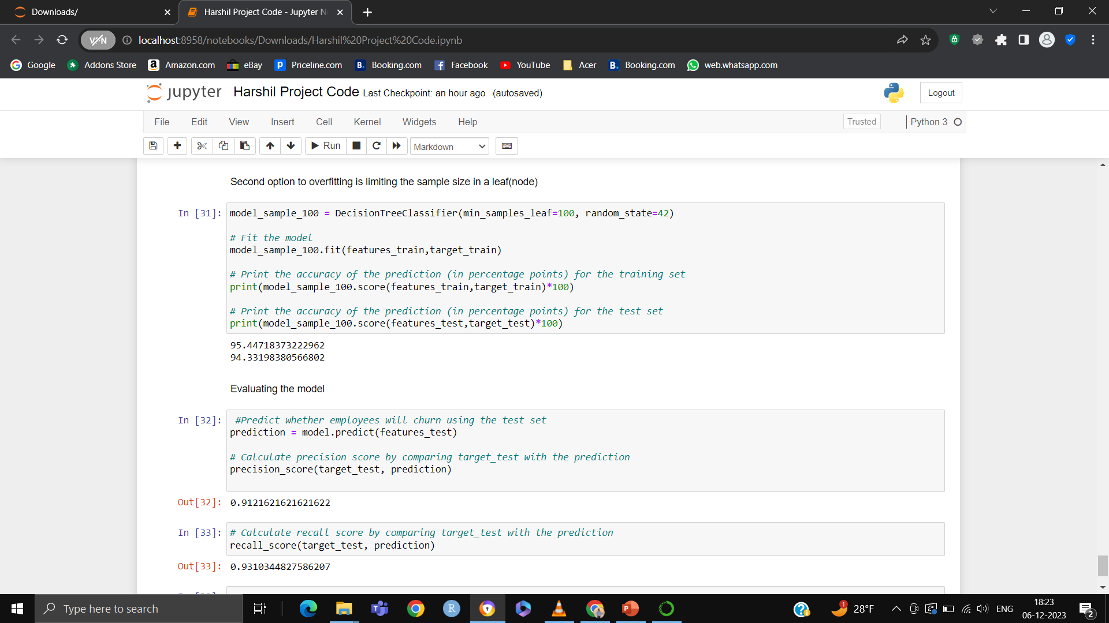
Decision Tree Model

Slide 12
Conclusion
One of the primary point also involves low salary employees are high likely to churn.
The HR department has the highest churn rate, so the company needs to consider what factors contributed to this.
The decision tree model is performing well with good precision and recall score.
This project involved dataset exploration, data preprocessing, handling missing values and the construction of a Decision Tree Classifier model to forecast employee churn.

Slide 13
References
1)Dogan, A., & Birant, D. (2021). Machine learning and data mining in manufacturing. Expert Systems with Applications, 166, 114060.
2)Wang, S., Cao, J., & Philip, S. Y. (2020). Deep learning for spatio-temporal data mining: A survey. IEEE transactions on knowledge and data engineering, 34(8), 3681-3700.

Slide 14
Thank you
Harshil Vekaria (@01441789)
Bala Krishna Mundru (@01449014)
Phani Madhav Addanki (@01443682)

